Slide 1
Environmental, Social, and Governance (ESG) and you!
Does improving your company’s sustainability model help your bottom line?

Slide 2
Table of Contents
Overview
Database Framework
Deliverables
ESG Trends
Target audience
Vision
Problems to solve
Proposed solution
Team
Project objective
Data Exploration

Slide 3

Overview
Here at ESG Consultants, we are building a machine learning module to help determine the impact of sustainability on a company’s stock performance.
Notes:
Deliverable: Selected topic

Slide 4
What is ESG &
Why is it Important?

Slide 5

What is ESG?
Set of standards used to measure a company’s adherence to environmental, social and corporate governance standards.
Notes:
Deliverable: Reason the topic is selected

Slide 6



Why is ESG Important?
Social
Governance
Environment
E
Health & Safety
Human Rights
G
S
Natural resources
Climate risk
Ethical standards
Shareholder rights
Notes:
Deliverable: Reason the topic is selected
Speaker Notes: Environment (E): 56% of population lives in cities and towns and account for 70% of CO₂ emissions by 2050 70% will live in towns and cities. The global temperature will rise by 1.5◦ C if we have Net Zero Emissions of CO₂ by 2050 otherwise may be more than 3.5◦ C.
Social (S): The global population is 8 billion set to rise to 8.5 billion by 2030 and 9.7 billion by 2050. Community Relations and Human Rights, Workplace Health and Safety, Diversity and Inclusion cannot be overlooked.
Governance(G): With a population of more than 8.5 billion and global temperatures rising the need for innovation in Policy and Code of Conduct, Supply Chain Management, CSR initiatives is a must for any company.

Slide 7
What do we want to know?
Is there a correlation between stock market performance and ESG ratings?
Can we balance balance ESG and turn a high profit?
1
3
2
What are the red flags that effect ESG ratings?
4
What can we do to help?
Notes:
Deliverable: Questions the team hopes to answer with the data

Slide 8
Project objective
Transform
Build
Visualize
Notes:
Deliverable: Description of the source of data
Transform publicly available data from Yahoo! Finance into a database for analysis.
Build a machine learning module to evaluate performance
Visualize the results in order to make predictions and draw conclusions.

Slide 9
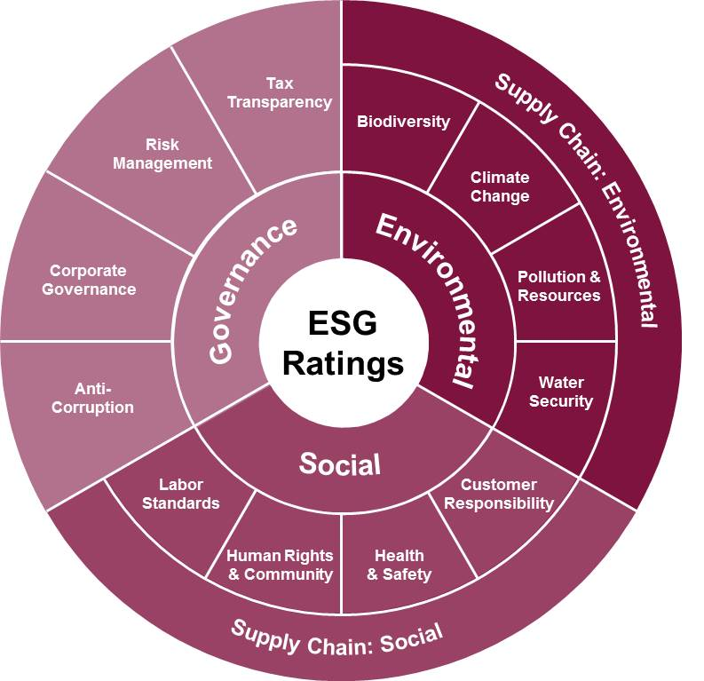
Target audience
Our dashboard is directed at financial investors who are looking to build their portfolio with sustainability in mind.
01 | Point 1 on outcome / results
02 | Point 2 on outcome / results
03 | Point 3 on outcome / results
04 | Point 4 on outcome / results
05 | Point 5 on outcome / results

Slide 10
The Data Source
Yahoo! Fiance & Yahoo! ESG
Sustainability parameters
Five years of historical stock price data
Notes:
Deliverable: Description of the source of data
Speaker Notes:
Sustainability parameters like environment, social, even public sentiment for various companies which have been rated highly based on their ESG initiatives.
Five years of historical stock price data to predict the stock prices using machine learning.

Slide 11
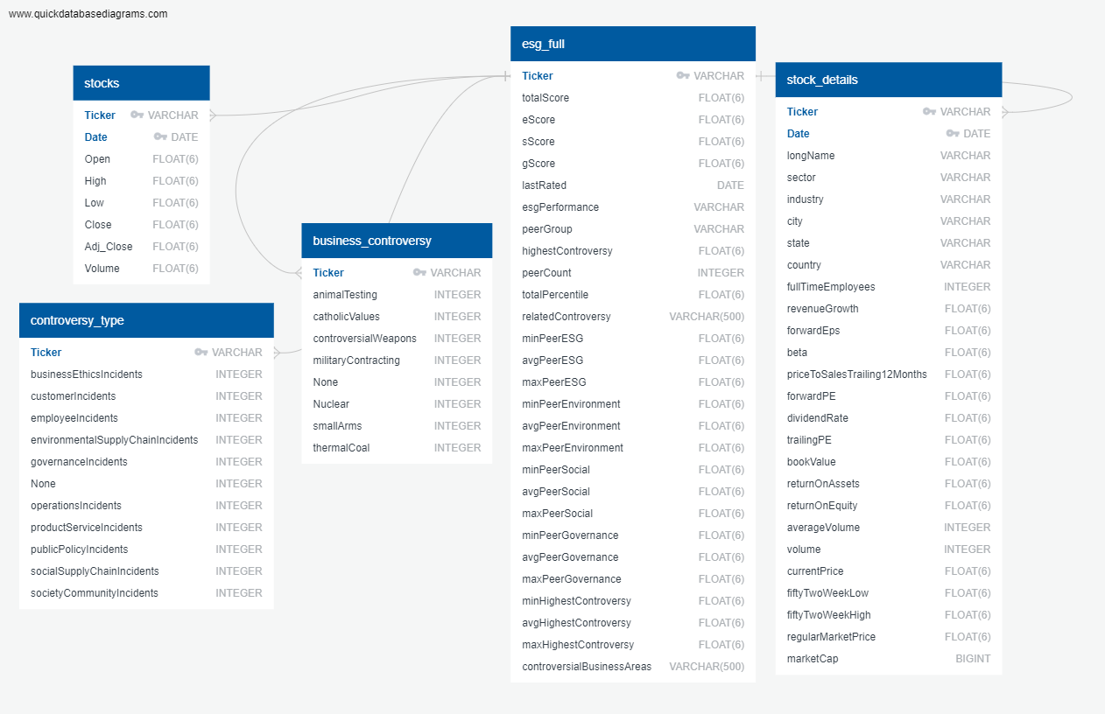
Database
Framework
Our Database contains:
stocks
controversy_type
business_controversy
esg_full
stock_details
Notes:
Deliverable: Description of the data exploration phase of the project

Slide 12



Data Exploration
Feature Engineering
Training & Test Sets
Data Preprocessing
01
Identify features for optimal performance.
Ensure proper encoders
03
02
Remove duplicate/null data.
Break data into smaller tables
Remove noisy data
Use test_train_split from sklearn to split data.
Scale data accordingly
Notes:
Deliverable: Description of the data exploration phase of the project

Slide 13
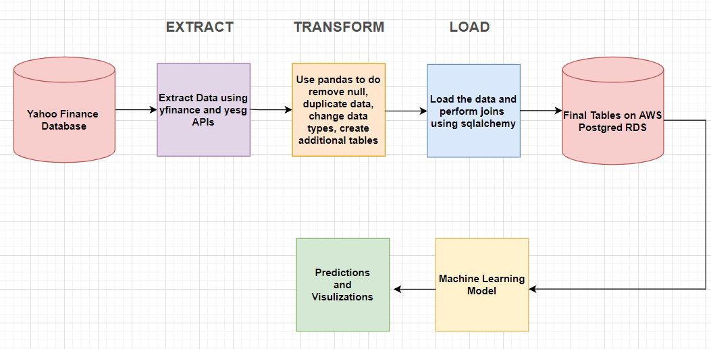
ETL Pipeline
Notes:
Deliverable: Description of the data exploration phase of the project

Slide 14
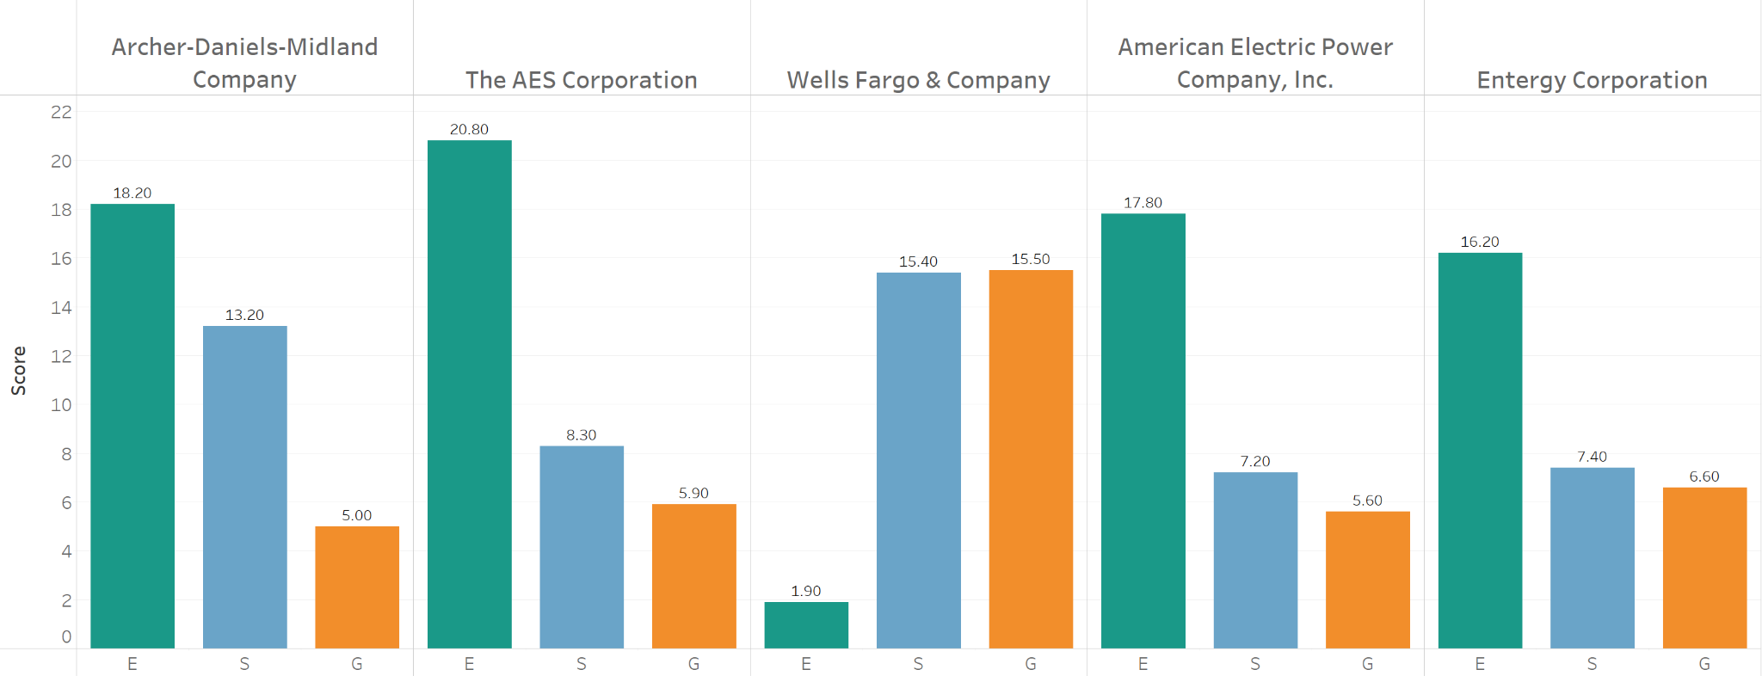
Leaders in ESG
Here are the top 5 companies based on overall ESG
Notes:
Deliverable: Result of the analysis

Slide 15
Here we can include more details on our findings
Trend 01
75%
Trend 01 notes
Trend 02
53%
Trend 02 notes
Notes:
Deliverable: Result of the analysis

Slide 16
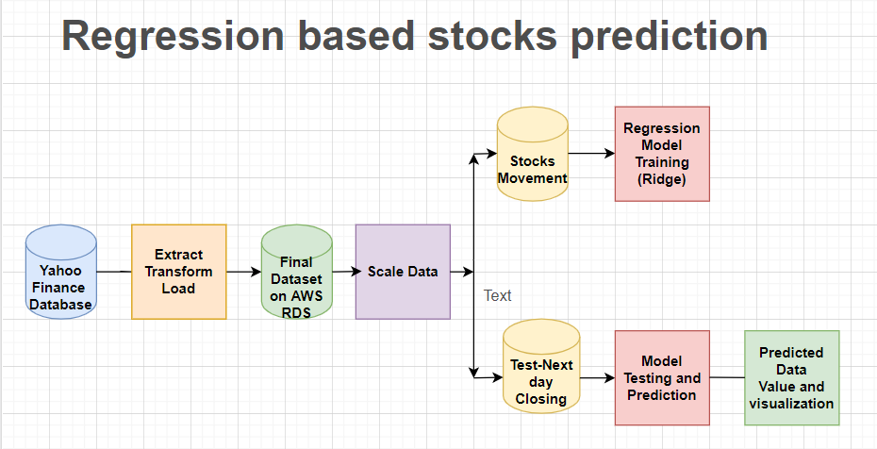
Machine Learning 1
Benefits
Limitations
Notes:
Deliverable: Description of the analysis phase of the project
Deliverable: Technologies, languages, tools, and algorithms used throughout the project
Speaker Notes: After reviewing various machine learning models, linear regression was used to formulate stock predictions for the next day
Benefits:
Can be used to find a colelation between ESG and company performance.
Easier to implement, interpret and train efficiently.
Ridge model used in this case helps to mitigate overfitting of the data.
Limitations:
This model does not account for varying broker fees, taxes, etc. which may affect changes in the data over time.
There are also a number of other models such as Facebook Prophet, ARIMA, LSTM which also handle non-stationary behaviours.

Slide 17
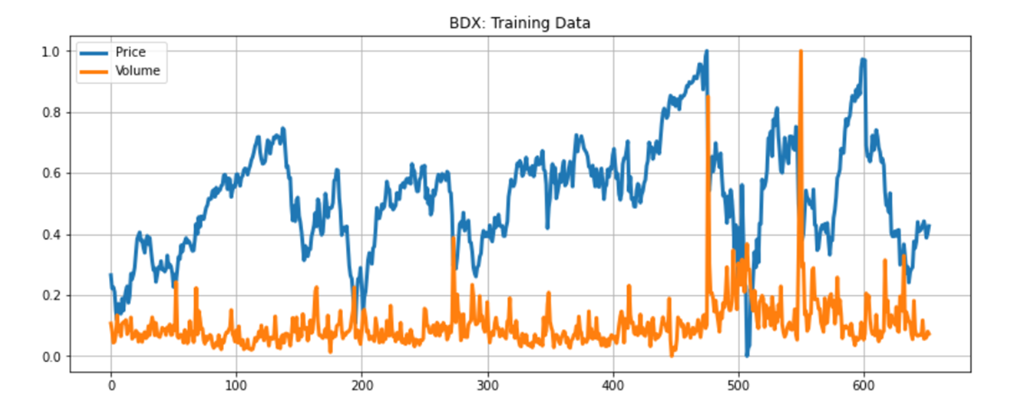
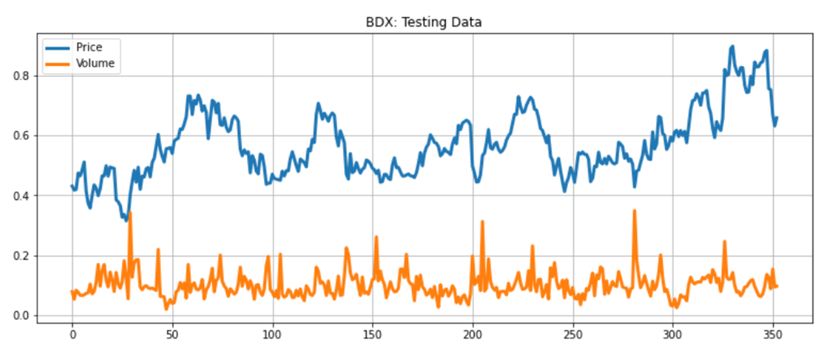
Training and Testing Data
Info: Outcomes of the test and training datasets
Notes:
Deliverable: Description of the analysis phase of the project
Deliverable: Technologies, languages, tools, and algorithms used throughout the project

Slide 18
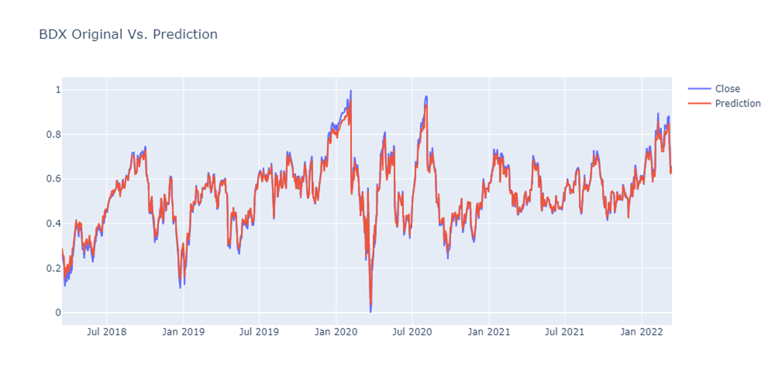
Stock Predictions
Notes:
Deliverable: Description of the analysis phase of the project
Deliverable: Technologies, languages, tools, and algorithms used throughout the project
Speaker Notes:
Our Machine Learning model was able to accurately predict the closing stock prices

Slide 19
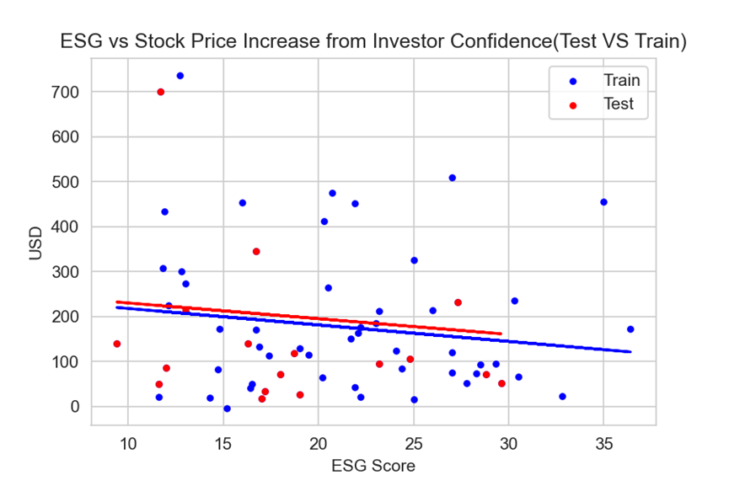
Machine Learning 2
Coefficients
Term | Value | StdErr | t-value | p-value
ESG | -3.66403 | 3.13783 | -1.1677 | 0.247329
intercept | 254.33 | 67.8833 | 3.74658 | 0.0003912
P-value: 0.247329
Equation: Difference = -3.66403*ESG + 254.33
Notes:
Deliverable: Description of the analysis phase of the project
Deliverable: Technologies, languages, tools, and algorithms used throughout the project
Speaker Notes:
Our second machine learning model compares ESG to stock prices
Benefits:
All the companies can use this method because sales are always positive. In the dividend method, if the current year dividend is Zero, we cannot use it.
No human intervention is needed (automation)
It shows a negative relationship between the value of Stock Price increase from investor confidence and ESG Score.
Limitations:
This method is for comparable companies(industry). We need to make sure all the companies in the same industry must have a similar size. ex: Sobey and Walmart are supermarkets, but one is national, and another is global
The K-value is 0.30, which is higher than 0.05. We cannot use this model to measure how many prices of ESG influences the stock price, but it shows us ESG has a negative relationship with the stock price.
Our model only uses 2022 information, which can show you a short-term relationship. If we can add past year information, it will establish an exact relationship.
Improvements: More Data, Increasing Scope and Time. In this model, we use 89 companies, that are not enough, and we only get the 2022 ESG score because the old information is not for the public.

Slide 20
The Dashboard
Why Tableau?
Tableau offers integration with our database increasing longevity and reusability
Tableau provides clean and easy ways to visualize our data
Storyboards allow our users to interact with our dashboard to drill down and learn more
Notes:
Deliverable: Result of the analysis

Slide 21
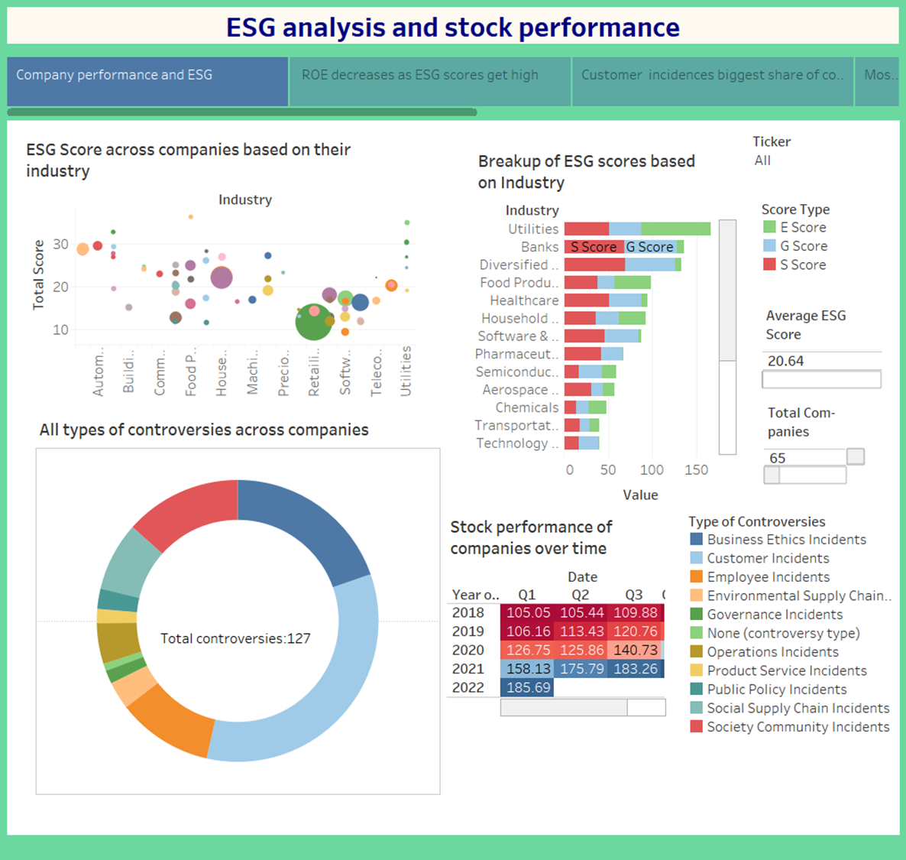
Integrated ESG Dashboard
Our interactive dashboard highlights the following areas:
ESG score vs RoE (bubble)
ESG score by industry (bar)
Red flags (# of incidents) by type
Stock performance over time
Notes:
Deliverable: Result of the analysis

Slide 22
User Interaction
Our Tableau storyboard includes the following interactive elements:
Ticker filters to drill down into specific stocks
Tooltips to provide additional insights
Notes:
Deliverable: Result of the analysis

Slide 23
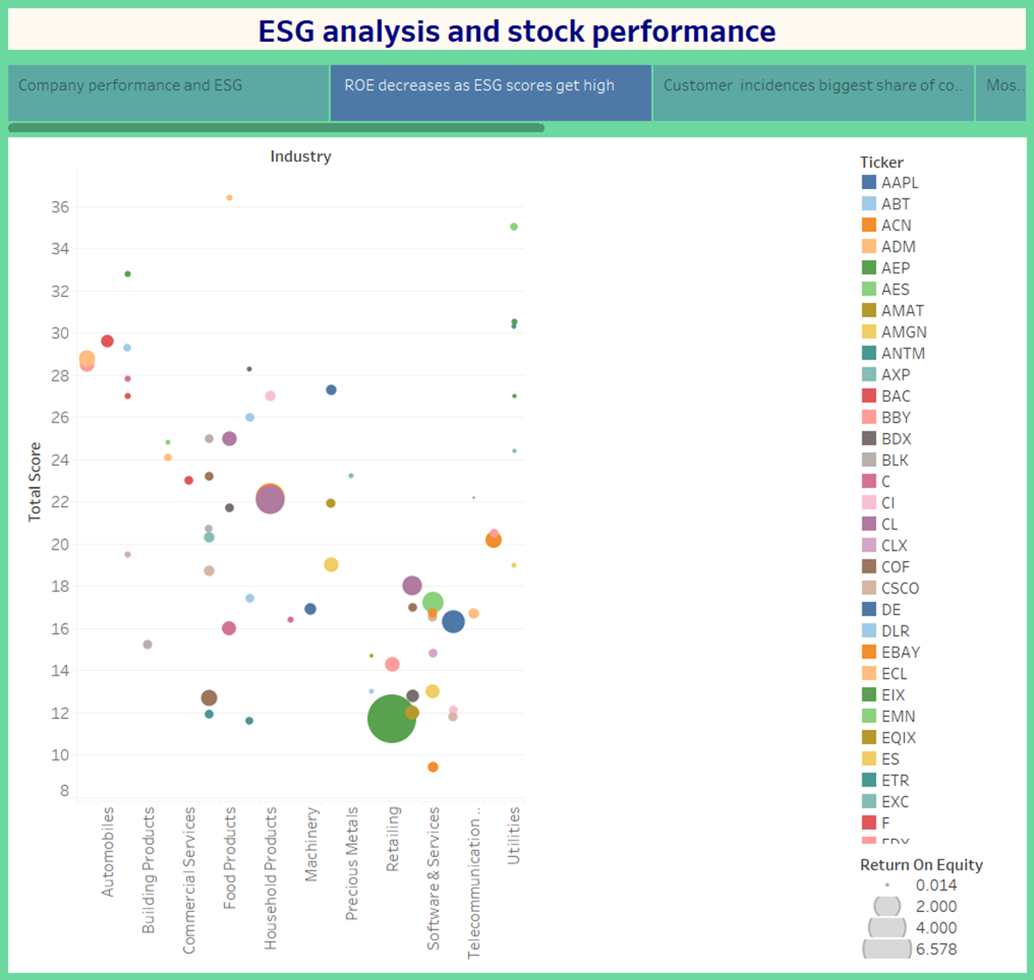
ESG Score vs RoE
Our Industry analysis concludes the following:
There is a negative correlation with RoE and ESG score
The retail industry has a high RoE, but very low ESG scores
Notes:
Deliverable: Result of the analysis

Slide 24
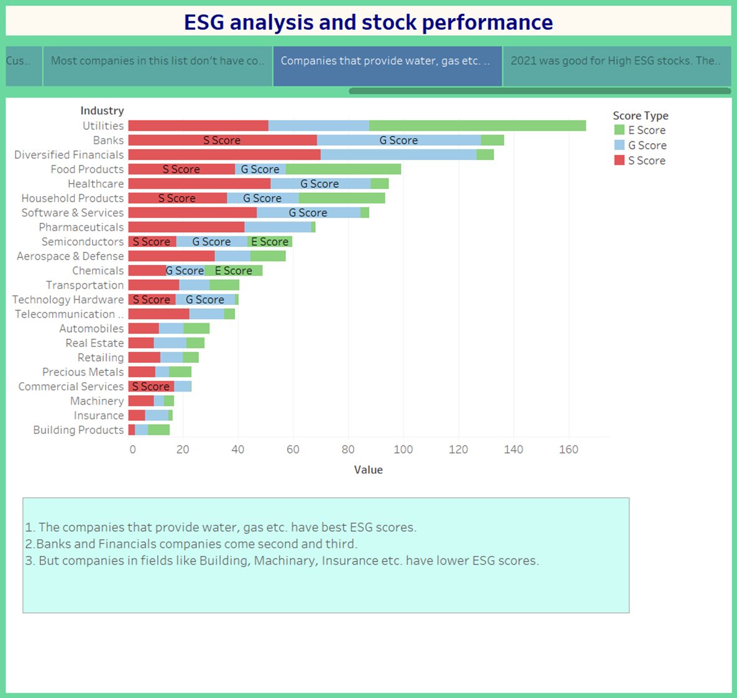
ESG score by Industry
Reviewing ESG scores by industry we can determine the following:
Utility companies have the best scores
Machinery, Insurance, Building products have low scores
Notes:
Deliverable: Result of the analysis

Slide 25
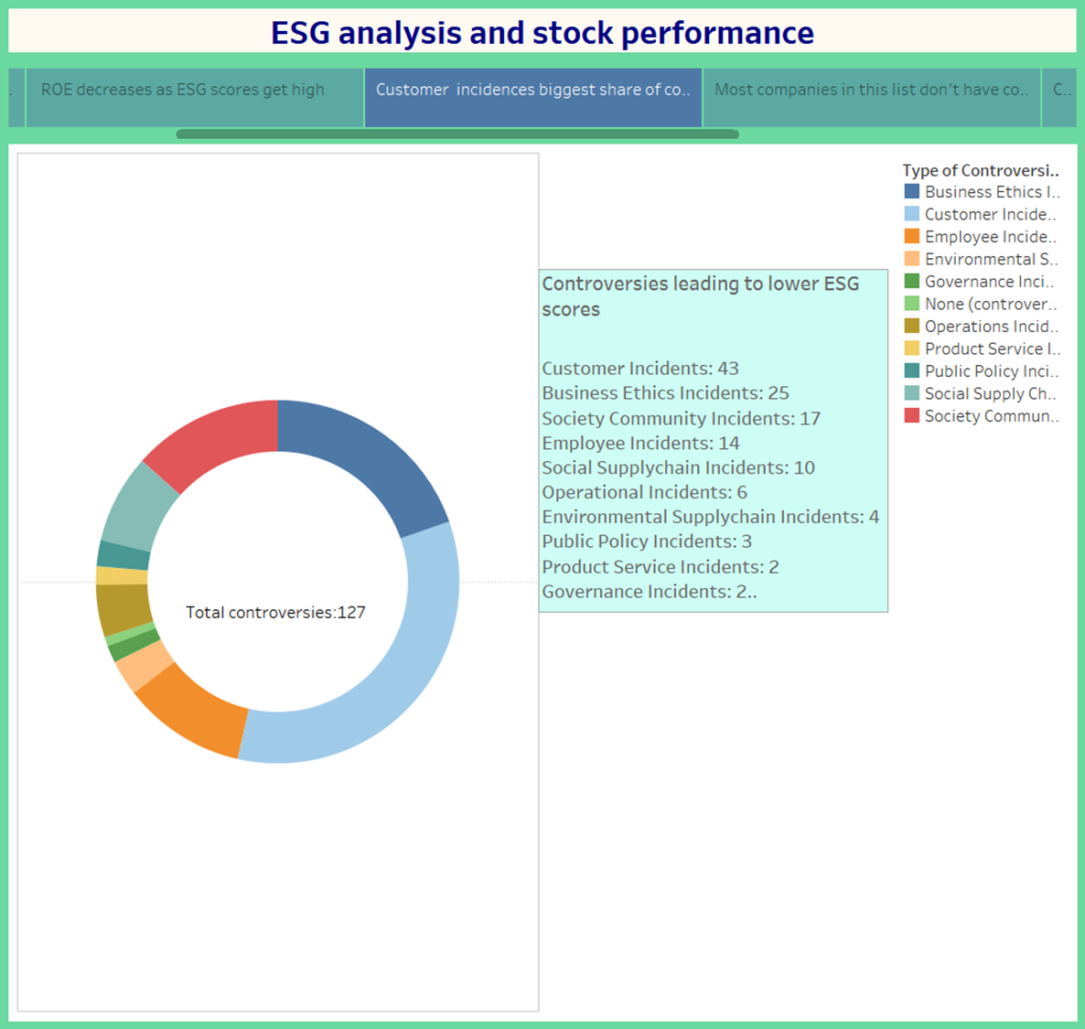
Controversy Indicators
Controversial behaviour have a negative impact on ESG scores
Business Ethics and Customer Incidents are more common types of incidents
Notes:
Deliverable: Result of the analysis

Slide 26
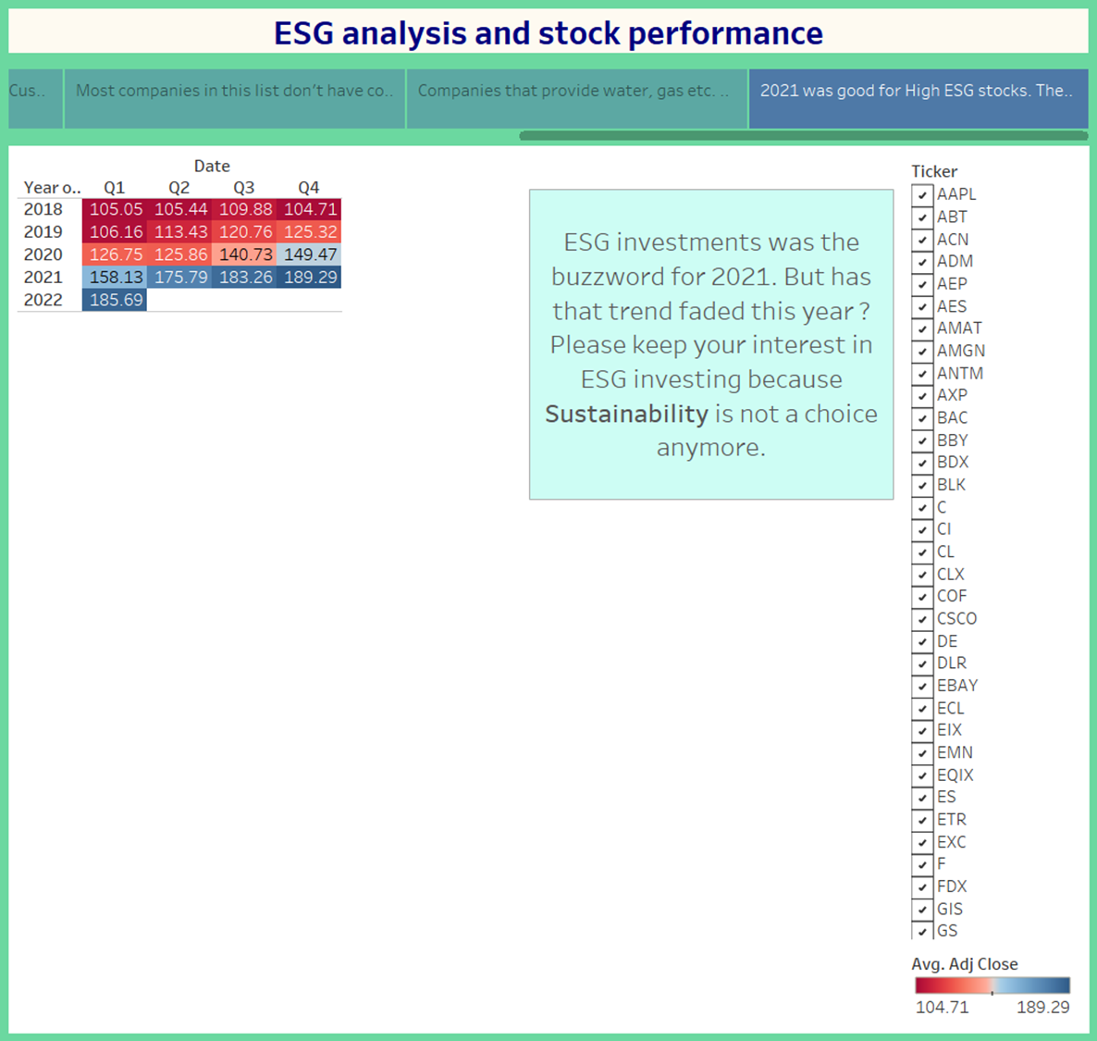
Stock Performance
Reviewing the stock performance, we can determine the following:
Performance is up as a whole
Notes:
Deliverable: Result of the analysis

Slide 27
Proposed solution
TBD - let’s see where machine learning takes us! :)
Notes:
Deliverable: Recommendation for future analysis

Slide 28
Deliverables
To be updated once our questions have been asked.
Metric 1
Metric 2
Metric 3
45K
690K
100K
Details on metric 1
Details on metric 1
Details on metric 1
Notes:
Deliverable: Recommendation for future analysis

Slide 29
Vision
Milestone 1
Milestone 3
Milestone 5
Milestone 2
Milestone 4
Details on Milestone 1
Details on Milestone 3
Details on Milestone 5
20XX
20XX
20XX
20XX
20XX
Details on Milestone 2
Details on Milestone 4
Notes:
Deliverable: Recommendation for future analysis

Slide 30
References
https://www.investopedia.com/terms/e/environmental-social-and-governance-esg-criteria.asp
https://ca.finance.yahoo.com/
https://ca.finance.yahoo.com/
https://www.forbes.com/just-companies/#5d410d762bf0
https://en.wikipedia.org/wiki/List_of_S%26P_500_companies
https://en.wikipedia.org/wiki/Environmental,_social_and_corporate_governance

Slide 31
Thank you.

